Slide 1
Overview of Java Language

Slide 2
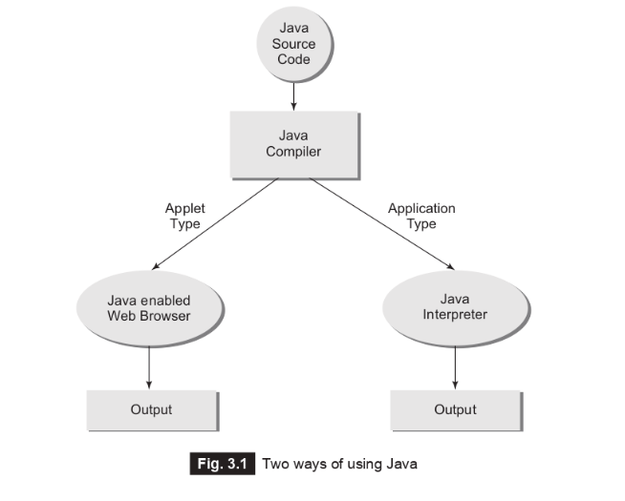
3.1 Introduction
Java is a general-purpose, object-oriented programming language. We can develop two types of Java programs:
1. Standalone applications
2. Web applets

Slide 3
Standalone applications are programs written in Java to carry out certain tasks on a standalone local computer.
In fact, Java can be used to develop programs for all kinds of applications, which earlier, were developed using languages like C and C++.
Executing a standalone Java program involves two steps:
1. Compiling source code into bytecode using javac compiler.
2. Executing the bytecode program using java interpreter.

Slide 4
Applets are small Java programs developed for Internet applications. An applet located on a distant computer (Server) can be downloaded via Internet and executed on a local computer (Client) using a Java-capable browser.
We can develop applets for doing everything from simple animated graphics to complex games and utilities.
Since applets are embedded in an HTML (Hypertext Markup Language) document and run inside a Web page, creating and running applets are more complex than creating an application.
Standalone programs can read and write ﬁles and perform certain operations that applets cannot do. An applet can only run within a Web browser.

Slide 5
3.2 Simple Java program
The best way to learn a new language is to write a few simple example programs and execute them. We begin with a very simple program that prints a line of text as output.
class HelloWorld{
public static void main(String args[]){
System.out.println(“Hello, world!”);
}
}
It is perhaps the simplest of all Java programs. Nevertheless, it brings out some salient features of the language.

Slide 6
3.5 Java program structure
a Java program may contain many classes of which only one class deﬁnes a main method.
Classes contain data members and methods that operate on the data members of the class. Methods may contain data type declarations and executable statements.
To write a Java program, we ﬁrst deﬁne classes and then put them together.
A Java program may contain one or more sections.

Slide 7
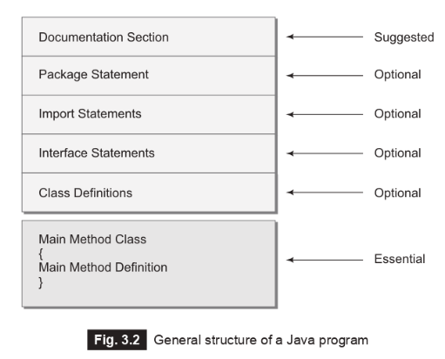

Slide 8
Documentation section
The documentation section comprises a set of comment lines giving the name of the program, the author and other details, which the programmer would like to refer to at a later stage.
Comments must explain why and what of classes and how of algorithms. This would greatly help in maintaining the program.
In addition to the two styles of comments discussed earlier, Java also uses a third style of comment /**....*/ known as documentation comment. This form of comment is used for generating documentation automatically.

Slide 9
Package statement
The ﬁrst statement allowed in a Java ﬁle is a package statement.
This statement declares a package name and informs the compiler that the classes deﬁned here belong to this package.
Example: package student;
The package statement is optional. That is, our classes do not have to be part of package.

Slide 10
Import statements
The next thing after a package statement (but before any class deﬁnitions) may be a number of import statements.
This is similar to the #include statement in C.
Example: import student.test;
This statement instructs the interpreter to load the test class contained in the package student. Using import statements, we can have access to classes that are part of other named packages.

Slide 11
Interface statements
An interface is like a class but includes a group of method declarations.
This is also an optional section and is used only when we wish to implement the multiple inheritance feature in the program.
Interface is a new concept in Java.

Slide 12
Class definitions
A Java program may contain multiple class deﬁnitions. Classes are the primary and essential elements of a Java program.
These classes are used to map the objects of real-world problems. The number of classes used depends on the complexity of the problem.
Main method class
Since every Java standalone program requires a main method as its starting point, this class is the essential part of a Java program.
A simple Java program may contain only this part. The main method creates objects of various classes and establishes communications between them.
On reaching the end of main, the program terminates and the control passes back to the operating system.

